Slide 1
Restaurant Menu Ordering System using C and Data structures : Team details : VISHNU VARDHAN - 24KB1A05AJ ROHITH REDDY - 24KB1A0521 GUNA SEKHAR - 24KB1A05EK MADHAN - 24KB1A05X6

Slide 2
INTRODUCTION : The Restaurant Menu Ordering System is a basic console-based application that allows users to view a menu, place orders, and receive a final bill. It simulates how customers interact with a digital menu system commonly found in modern restaurants. This project strengthens fundamental programming skills and problem-solving techniques.
Key Features :
Menu Display: Shows food items with prices in ₹.
Order Placement: Users can select items and quantities.
Bill Calculation: Computes total cost automatically.
Simple Interface: Easy input and clear instructions.
Multiple Orders: Supports ordering several items at once.
Error Handling: Catches invalid item numbers.
Modular Code: Separate functions for menu, order, and billing.

Slide 3
Objective: . The main objective of this project is to: . Create an interactive menu display. . Allow customers to place multiple orders. . Calculate and display the final bill with the total amount in Rupees.

Slide 4
Why C and Data structures ? Why C : C is a foundational programming language that provides low-level memory control and high performance. Learning C enhances understanding of important concepts like pointers, memory allocation, and efficient program structure. C is widely used in system-level programming, embedded systems, and real-time applications. Why Data structures : Data Structures (like arrays, lists) are crucial for organizing and managing menu items and orders efficiently. Algorithms help in building efficient solutions (like adding orders, calculating bills). Understanding DSA prepares the groundwork for more complex projects and problem-solving in the real world.

Slide 5
ALGORITHM:
Step 1: Start the program.
Step 2: Create a menu list/dictionary with item names and their prices (in ₹).
Step 3: Display the menu to the user showing item numbers, names, and prices.
Step 4: Ask the user to enter the item number they wish to order.
Step 5: If the item number is valid:
Ask the user for the quantity of that item.
Save the item name, price, and quantity into an order list.
If the item number is invalid:
Show an error message.
Ask the user to re-enter a valid item number.

Slide 6
ALOGORITHM: Step 6: Repeat Step 4 and Step 5 until the user enters 0 (they have finished orderinmeaningg).
Step 7: After ordering is complete, calculate the total bill:
For each item ordered, multiply the price by the quantity to get a subtotal.
Add up all the subtotals to get the grand total.
Step 8: Display the final bill:
List each item, quantity, and subtotal.
Show the grand total amount at the end.
Step 9: End

Slide 7
Lesson Learnt : Gained deeper understanding of basic programming concepts like loops, conditionals, and functions. Practiced handling user input and validating data. Understood how data structures (arrays/lists) store real-world data like orders. Realized the importance of a clear, user-friendly interface even in simple applications. Learned how to build modular code that separates display, input, and calculation tasks.

Slide 8
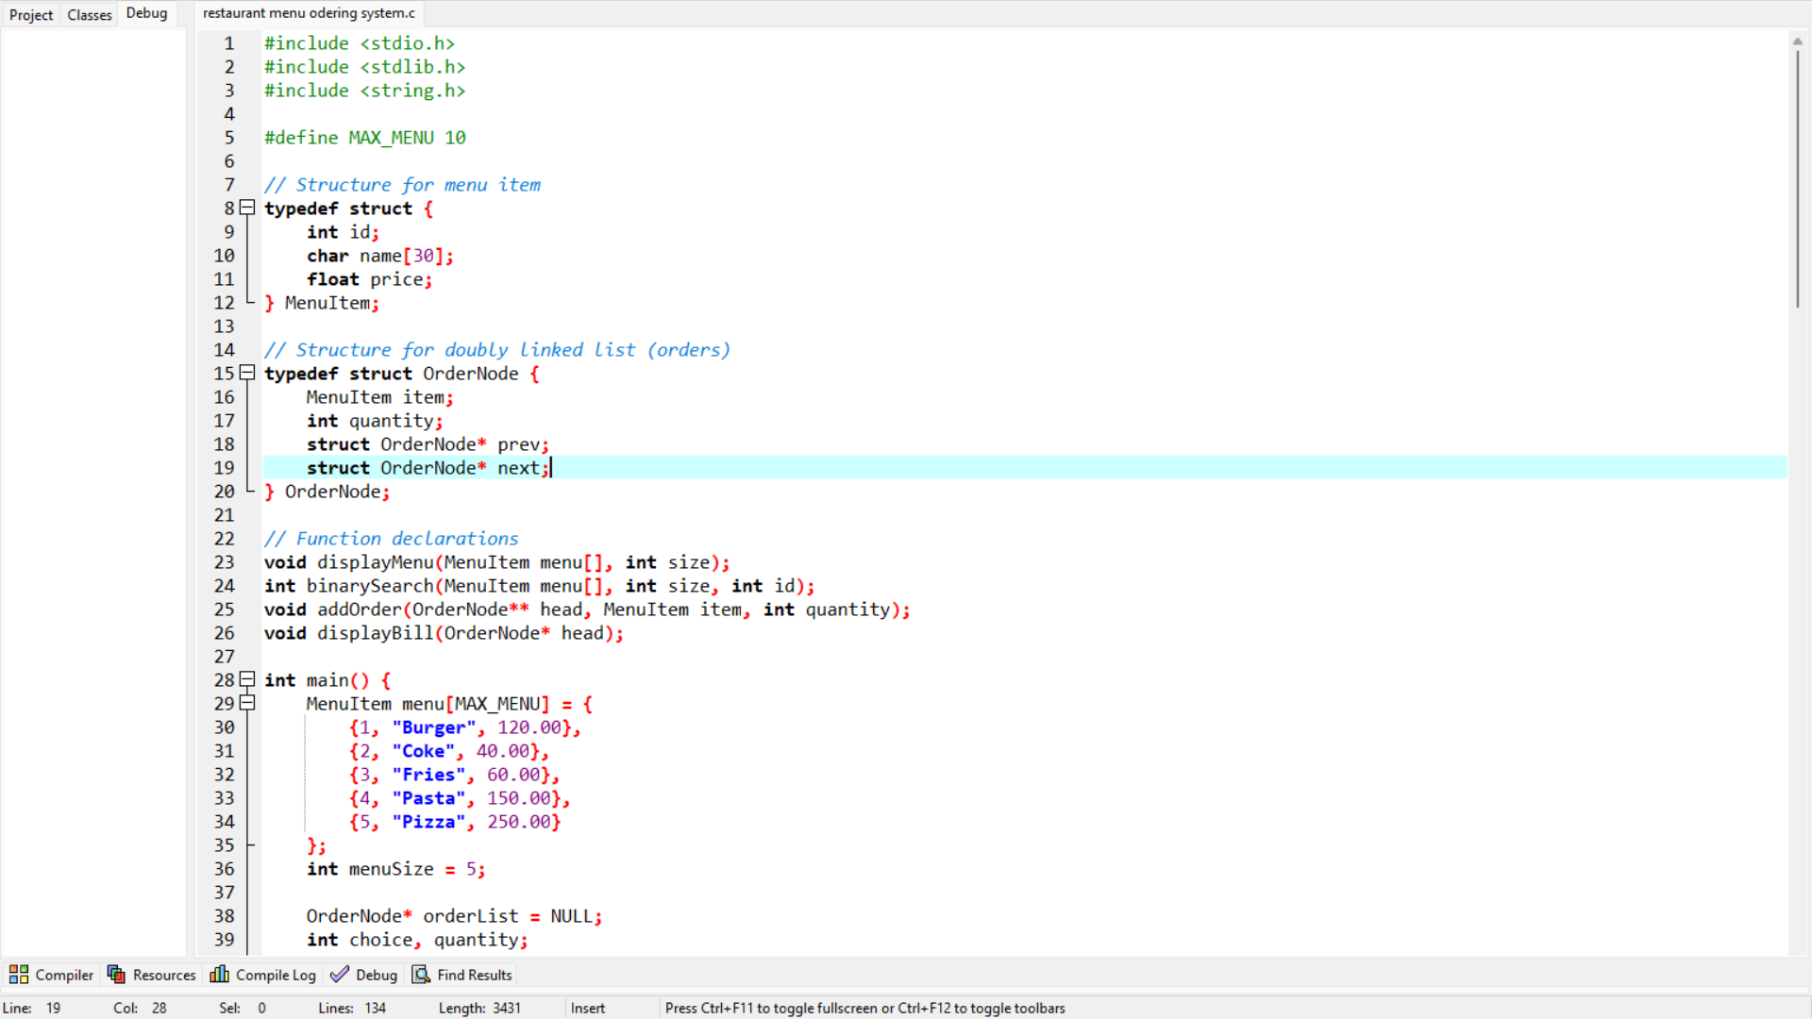
IMAGES

Slide 9
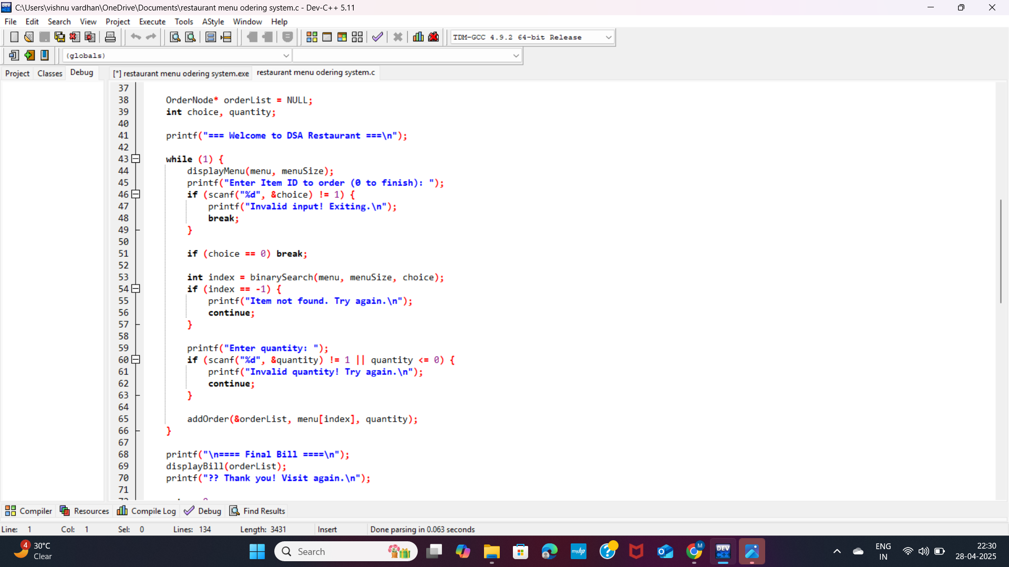
IMAGES

Slide 10
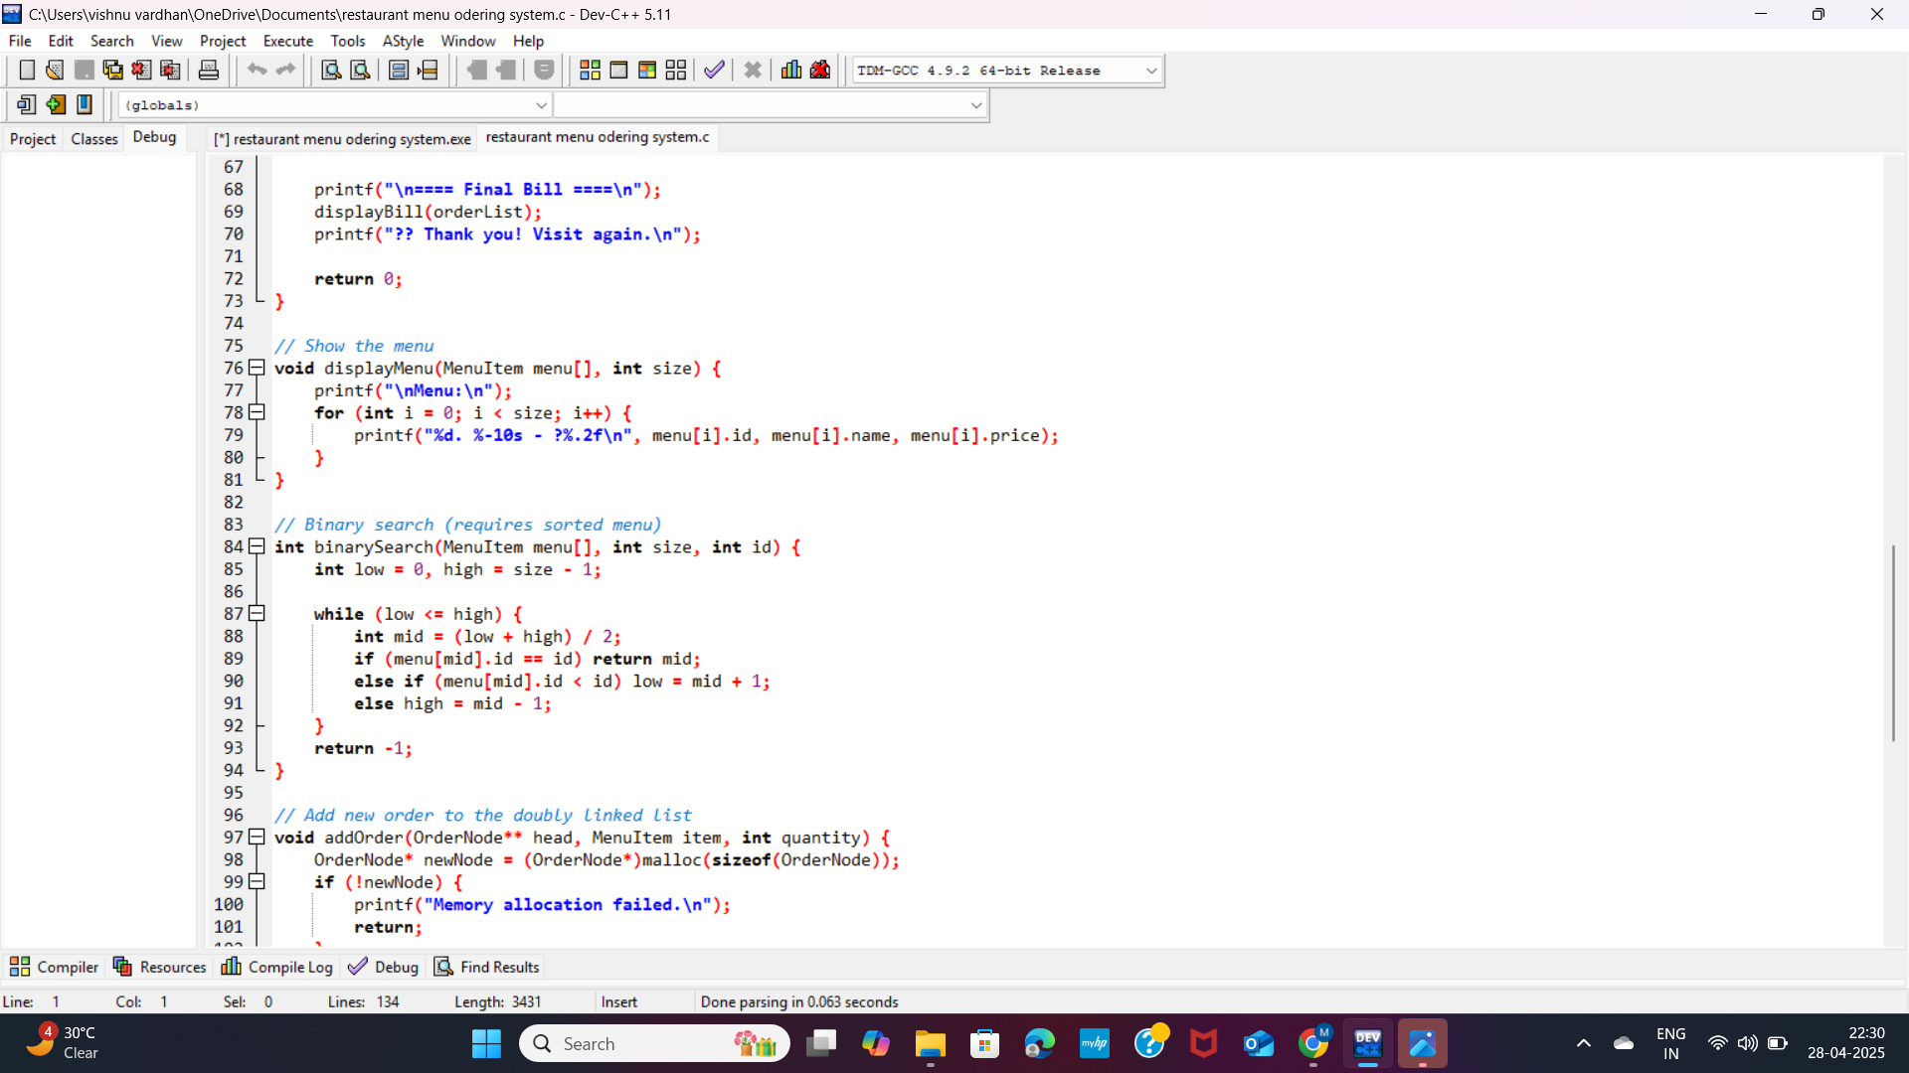
IMAGES

Slide 11
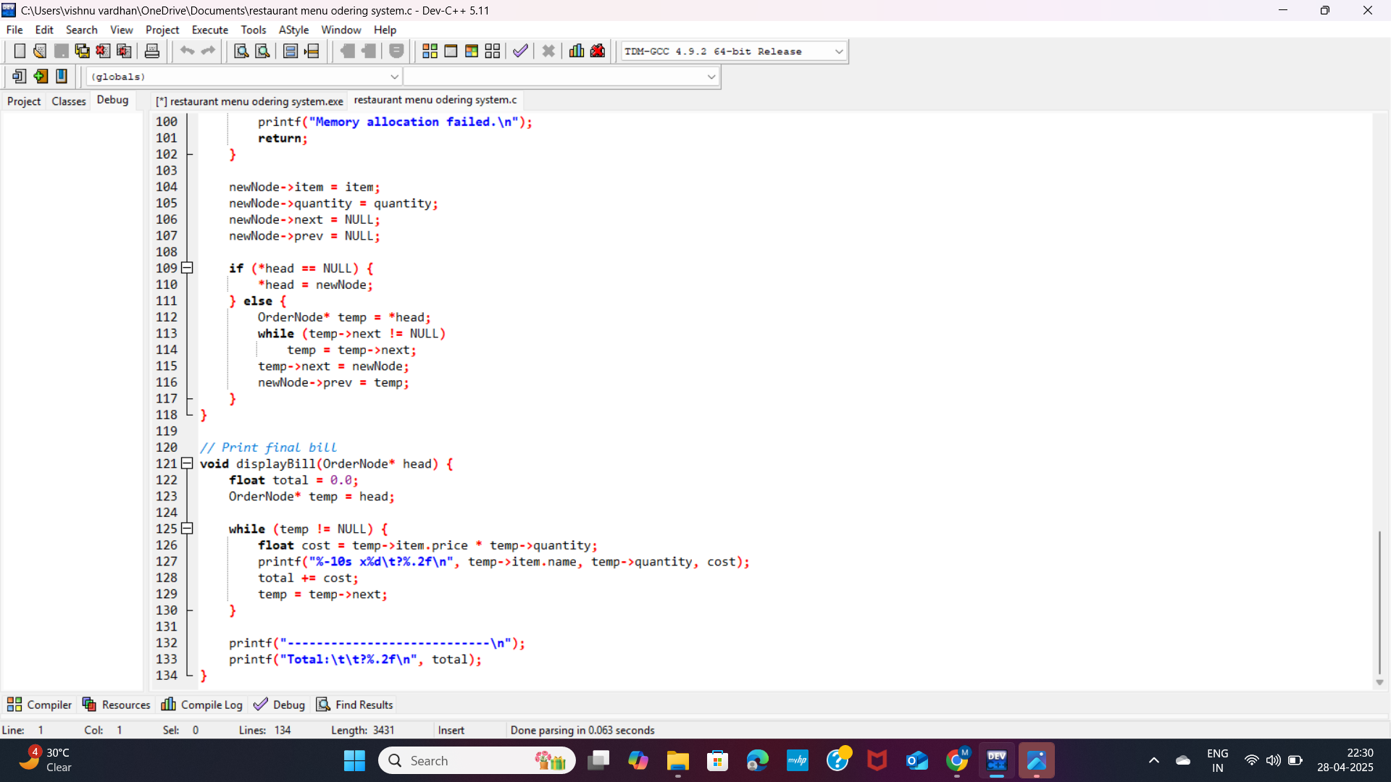
IMAGES

Slide 12
ee
OUTPUT :
--- Menu --- 1. Pizza - ₹250 2. Burger - ₹150 3. Pasta - ₹200 4. Salad - ₹120 5. Soda - ₹40 Enter item (0 to finish): 2 Quantity: 2 Enter item (0 to finish): 5 Quantity: 3 Enter item (0 to finish): 1 Quantity: 1 Enter item (0 to finish): 0 --- Final Bill --- Burger x2 - ₹300 Soda x3 - ₹120 Pizza x1 - ₹250 Total: ₹670

Slide 13
CONCLUSION We successfully implemented a real-world resturant menu ordering system, strengthening our skills in C programming, linked lists, and problem-solving. Thank you! Grateful for your time and attention.

